Slide 1

AML 3303: Cloud Technologies for AI and ML

Slide 2
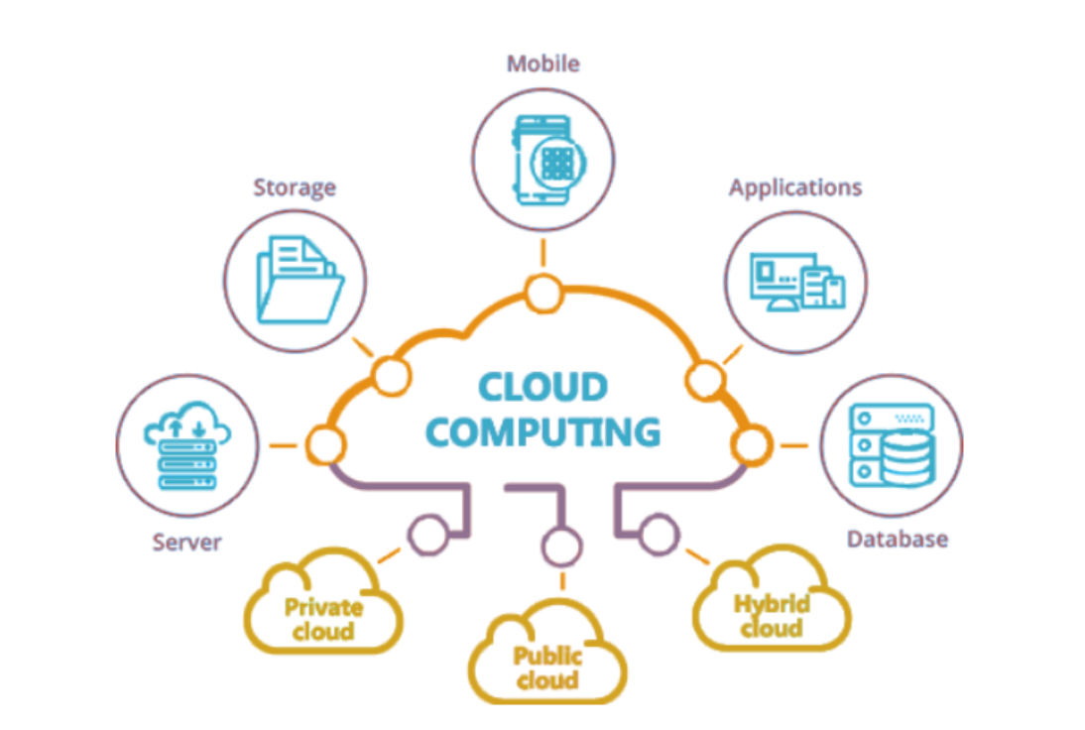

Introduction to Cloud Computing
Cloud computing delivers computing services—servers, storage, databases, networking, analytics, software, and intelligence—over the internet (“the cloud”).
Why Cloud for AI/ML:
Scalable compute for training large models.
Centralized data access.
Pay only for what you use.
Easier collaboration and deployment.
Example Companies:
Netflix, Spotify, Airbnb, Uber, OpenAI — all use cloud infrastructure for ML and analytics.

Slide 3
Core Characteristics of Cloud
Feature | Description
On-demand self-service | Provision compute/storage instantly without human intervention.
Broad network access | Access from any device or location.
Resource pooling | Shared infrastructure serving multiple customers.
Rapid elasticity | Scale up or down automatically.
Measured service | Pay for usage (compute hours, storage, bandwidth).

Slide 4
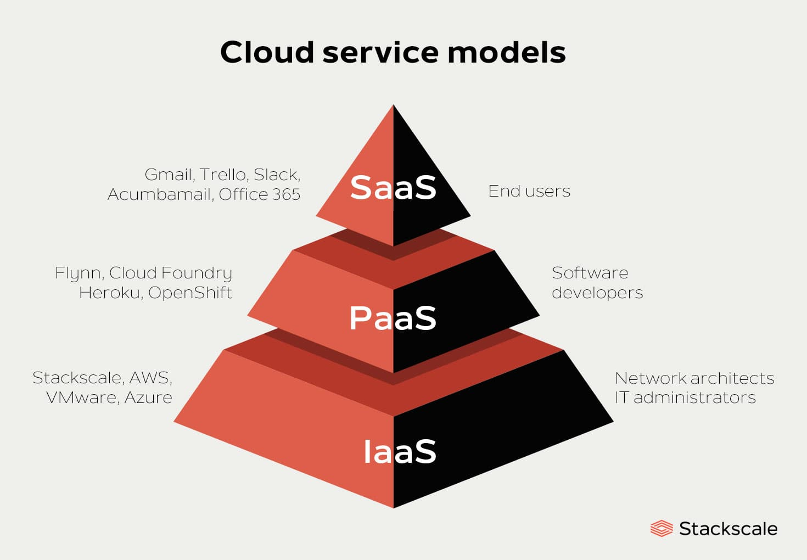
Cloud Service Models
🧩 ML engineers typically work with IaaS and PaaS.
Model | Description | Who Manages What | Example
IaaS | Infrastructure as a Service | You manage OS, runtime, data, apps | AWS EC2, Azure VM
PaaS | Platform as a Service | Provider manages OS/runtime | Google App Engine, AWS Elastic Beanstalk
SaaS | Software as a Service | Everything managed by provider | Google Workspace, Salesforce

Slide 5
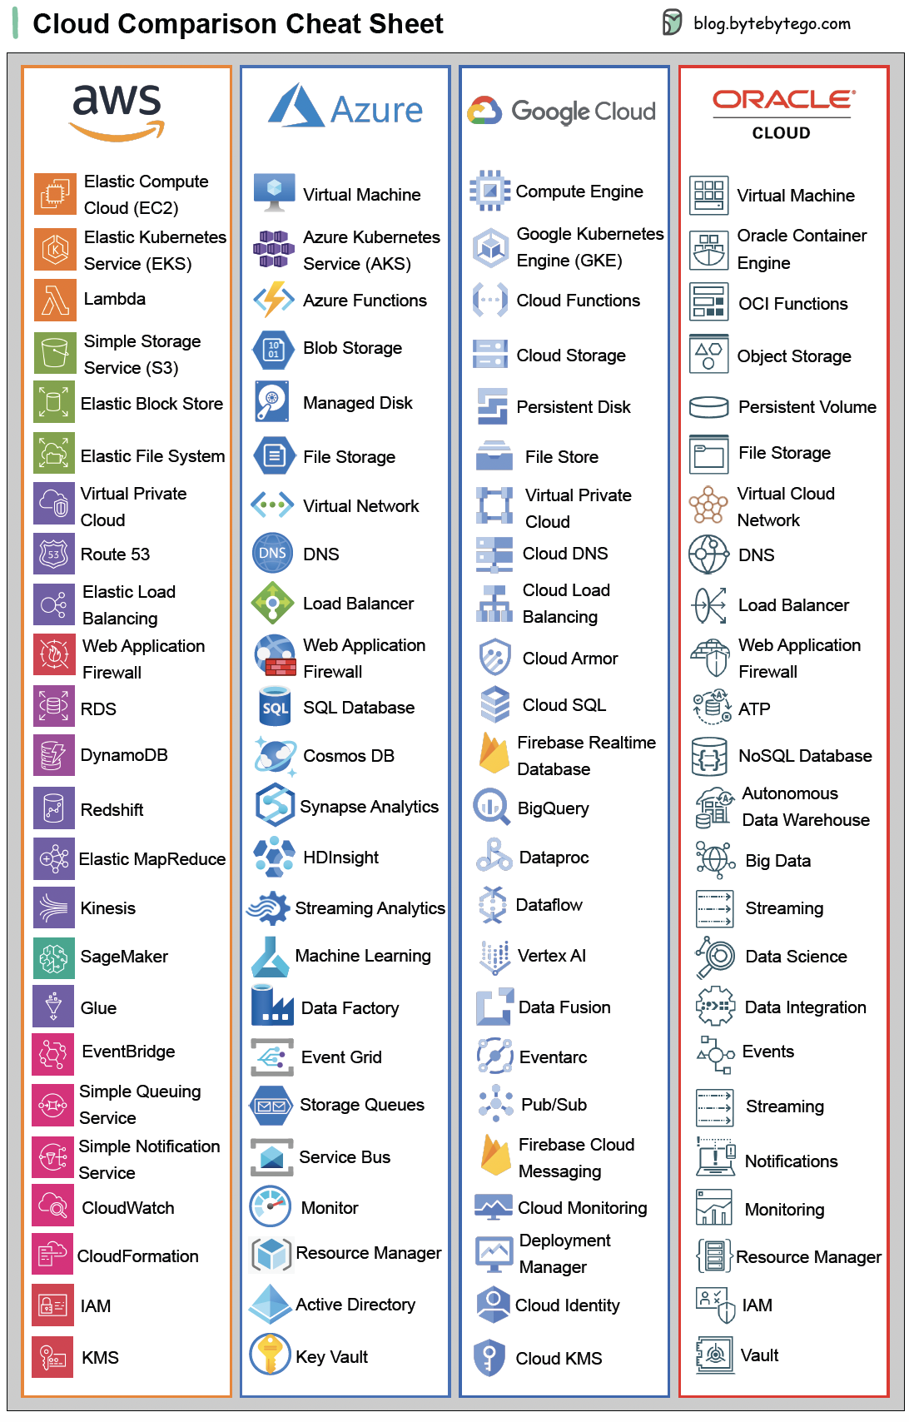
Major Cloud Providers
Provider | Strength | ML/AI Tools
AWS | Market leader, mature ecosystem | SageMaker, EC2, S3, Lambda
Google Cloud (GCP) | Data and AI innovation | Vertex AI, BigQuery, AutoML
Microsoft Azure | Enterprise integrations | Azure ML, Synapse Analytics
IBM Cloud | AI-focused enterprise tools | Watson Studio
Oracle Cloud | Data management, analytics | OCI Data Science

Slide 6
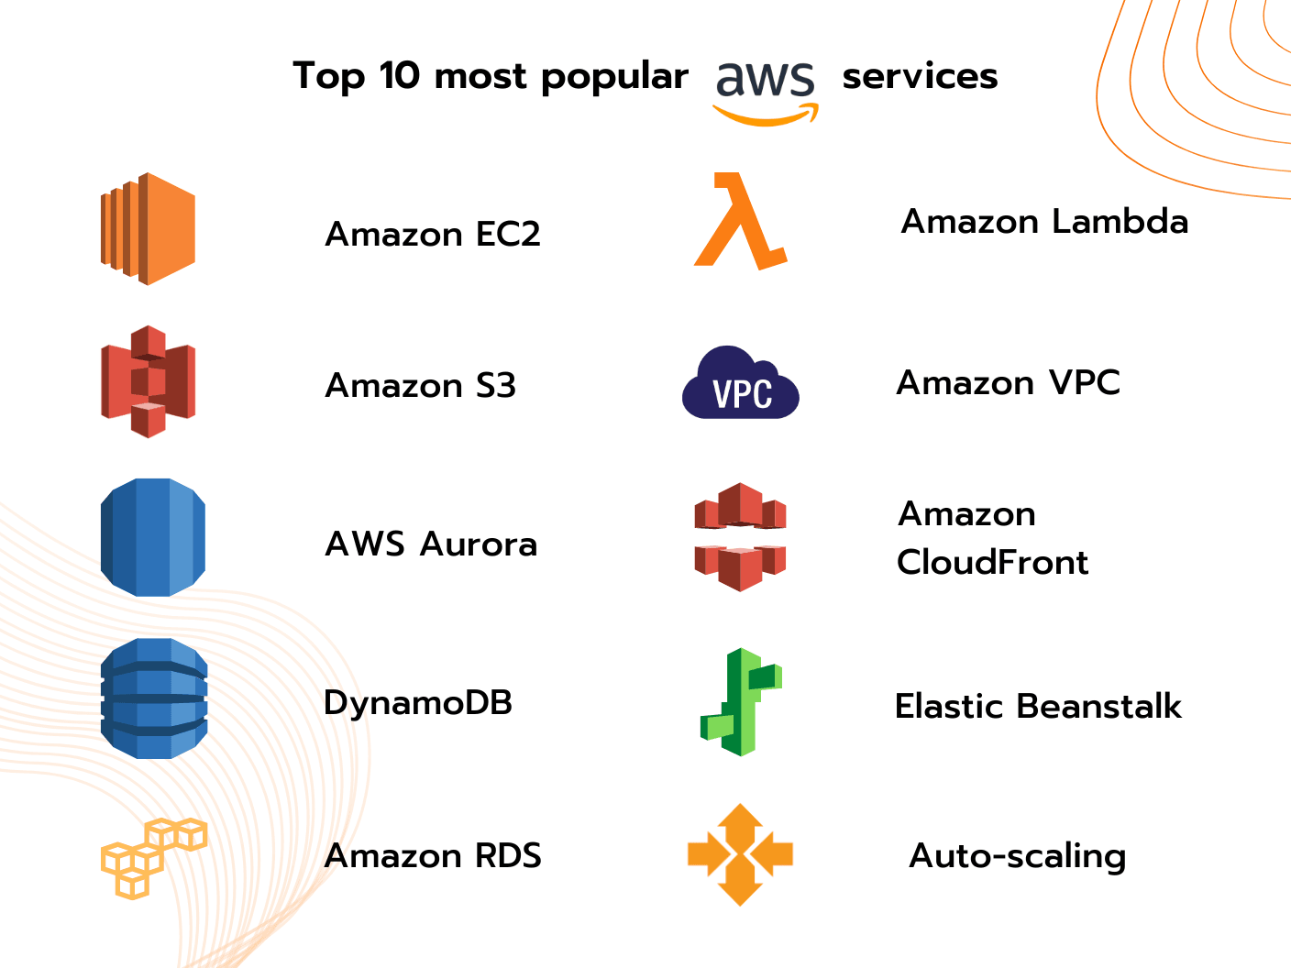
AWS Overview – The Industry Standard
Amazon Web Services (AWS) is the most widely adopted platform.
Offers 200+ fully featured services, including compute, storage, database, ML, and IoT.
Popular AI/ML-related services:
EC2: Virtual compute instances.
S3: Object storage for data and models.
SageMaker AI: End-to-end ML workflow platform.
Bedrock: Foundation models through an API.
Lambda: Serverless compute.
IAM: User access control.
ECS/EKS: Container orchestration.

Slide 7
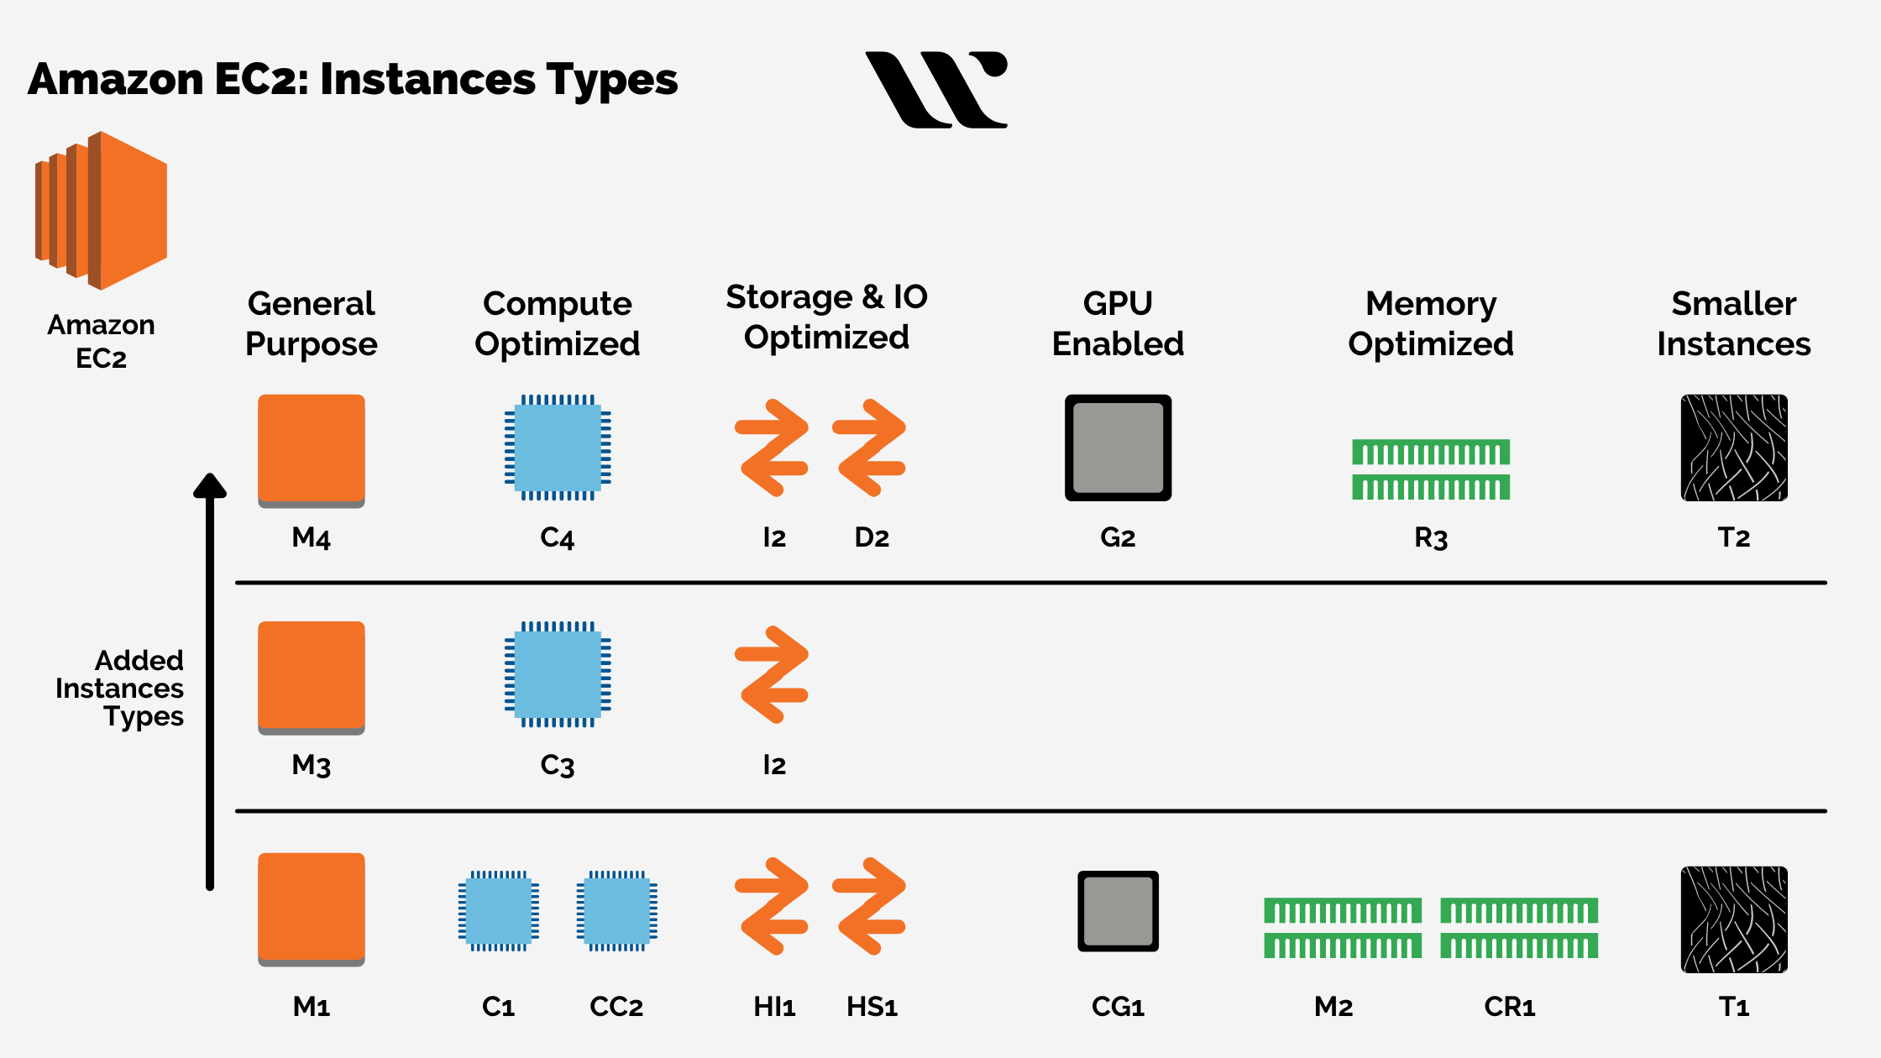
Compute – EC2 (Elastic Compute Cloud)
Purpose: Run your applications or ML workloads in virtual machines.
Key Concepts:
Choose instance type (CPU, GPU, memory).
Use spot instances for cheap experiments.
Stop/start instances anytime.
Can host Jupyter, MLflow, or training scripts.

Slide 8
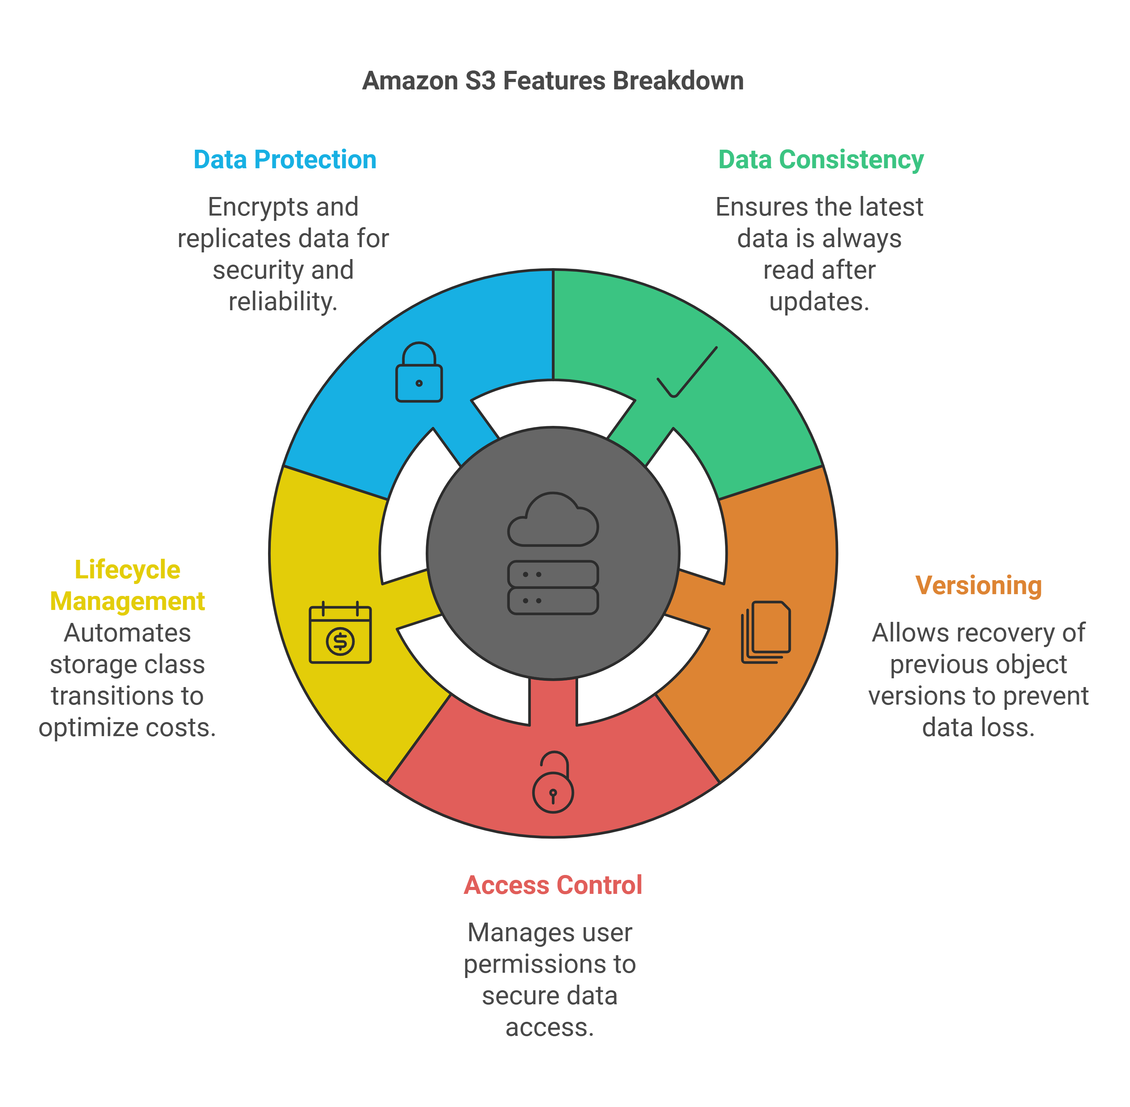
Storage – S3 (Simple Storage Service)
Purpose: Store data, models, and logs securely and access them globally.
Features:
Scalable object storage.
Organize files as buckets and objects.
Versioning and lifecycle rules.
Integrates with ML frameworks and MLOps tools.

Slide 9
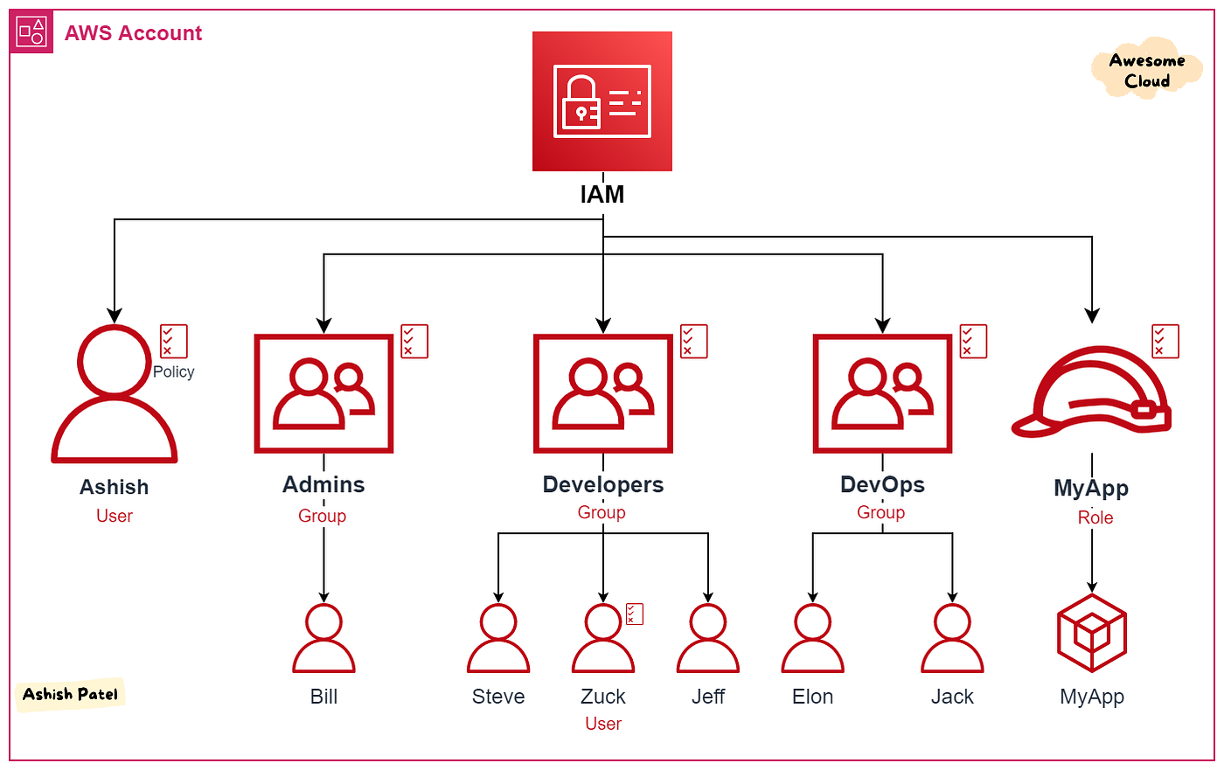
Security – IAM (Identity and Access Management)
Users: Individuals accessing AWS.
Groups: Combine users with the same permissions.
Roles: Assign temporary permissions to services.
Policies: Define what actions are allowed.

Slide 10
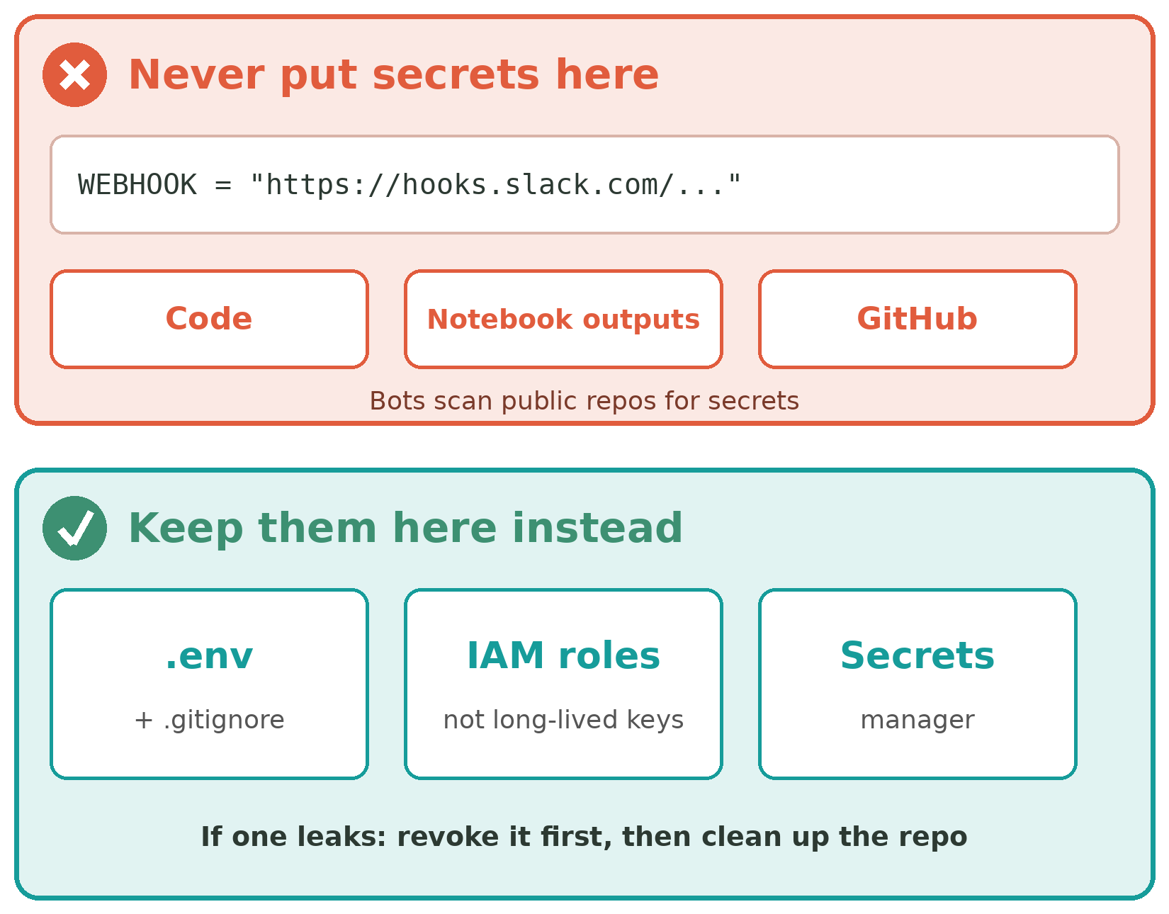
Cloud Security Basics for ML
MFA: turn it on for the root account and do not use root day to day.
Least privilege: give each user or role only the permissions it needs.
Roles first: prefer IAM roles over long-lived access keys.
No secrets in code: keys, tokens and webhook URLs never go in notebooks or GitHub.
Keep them in a .env file listed in .gitignore, or a secrets manager.
If one leaks: revoke it first, then clean up the repo.

Slide 11
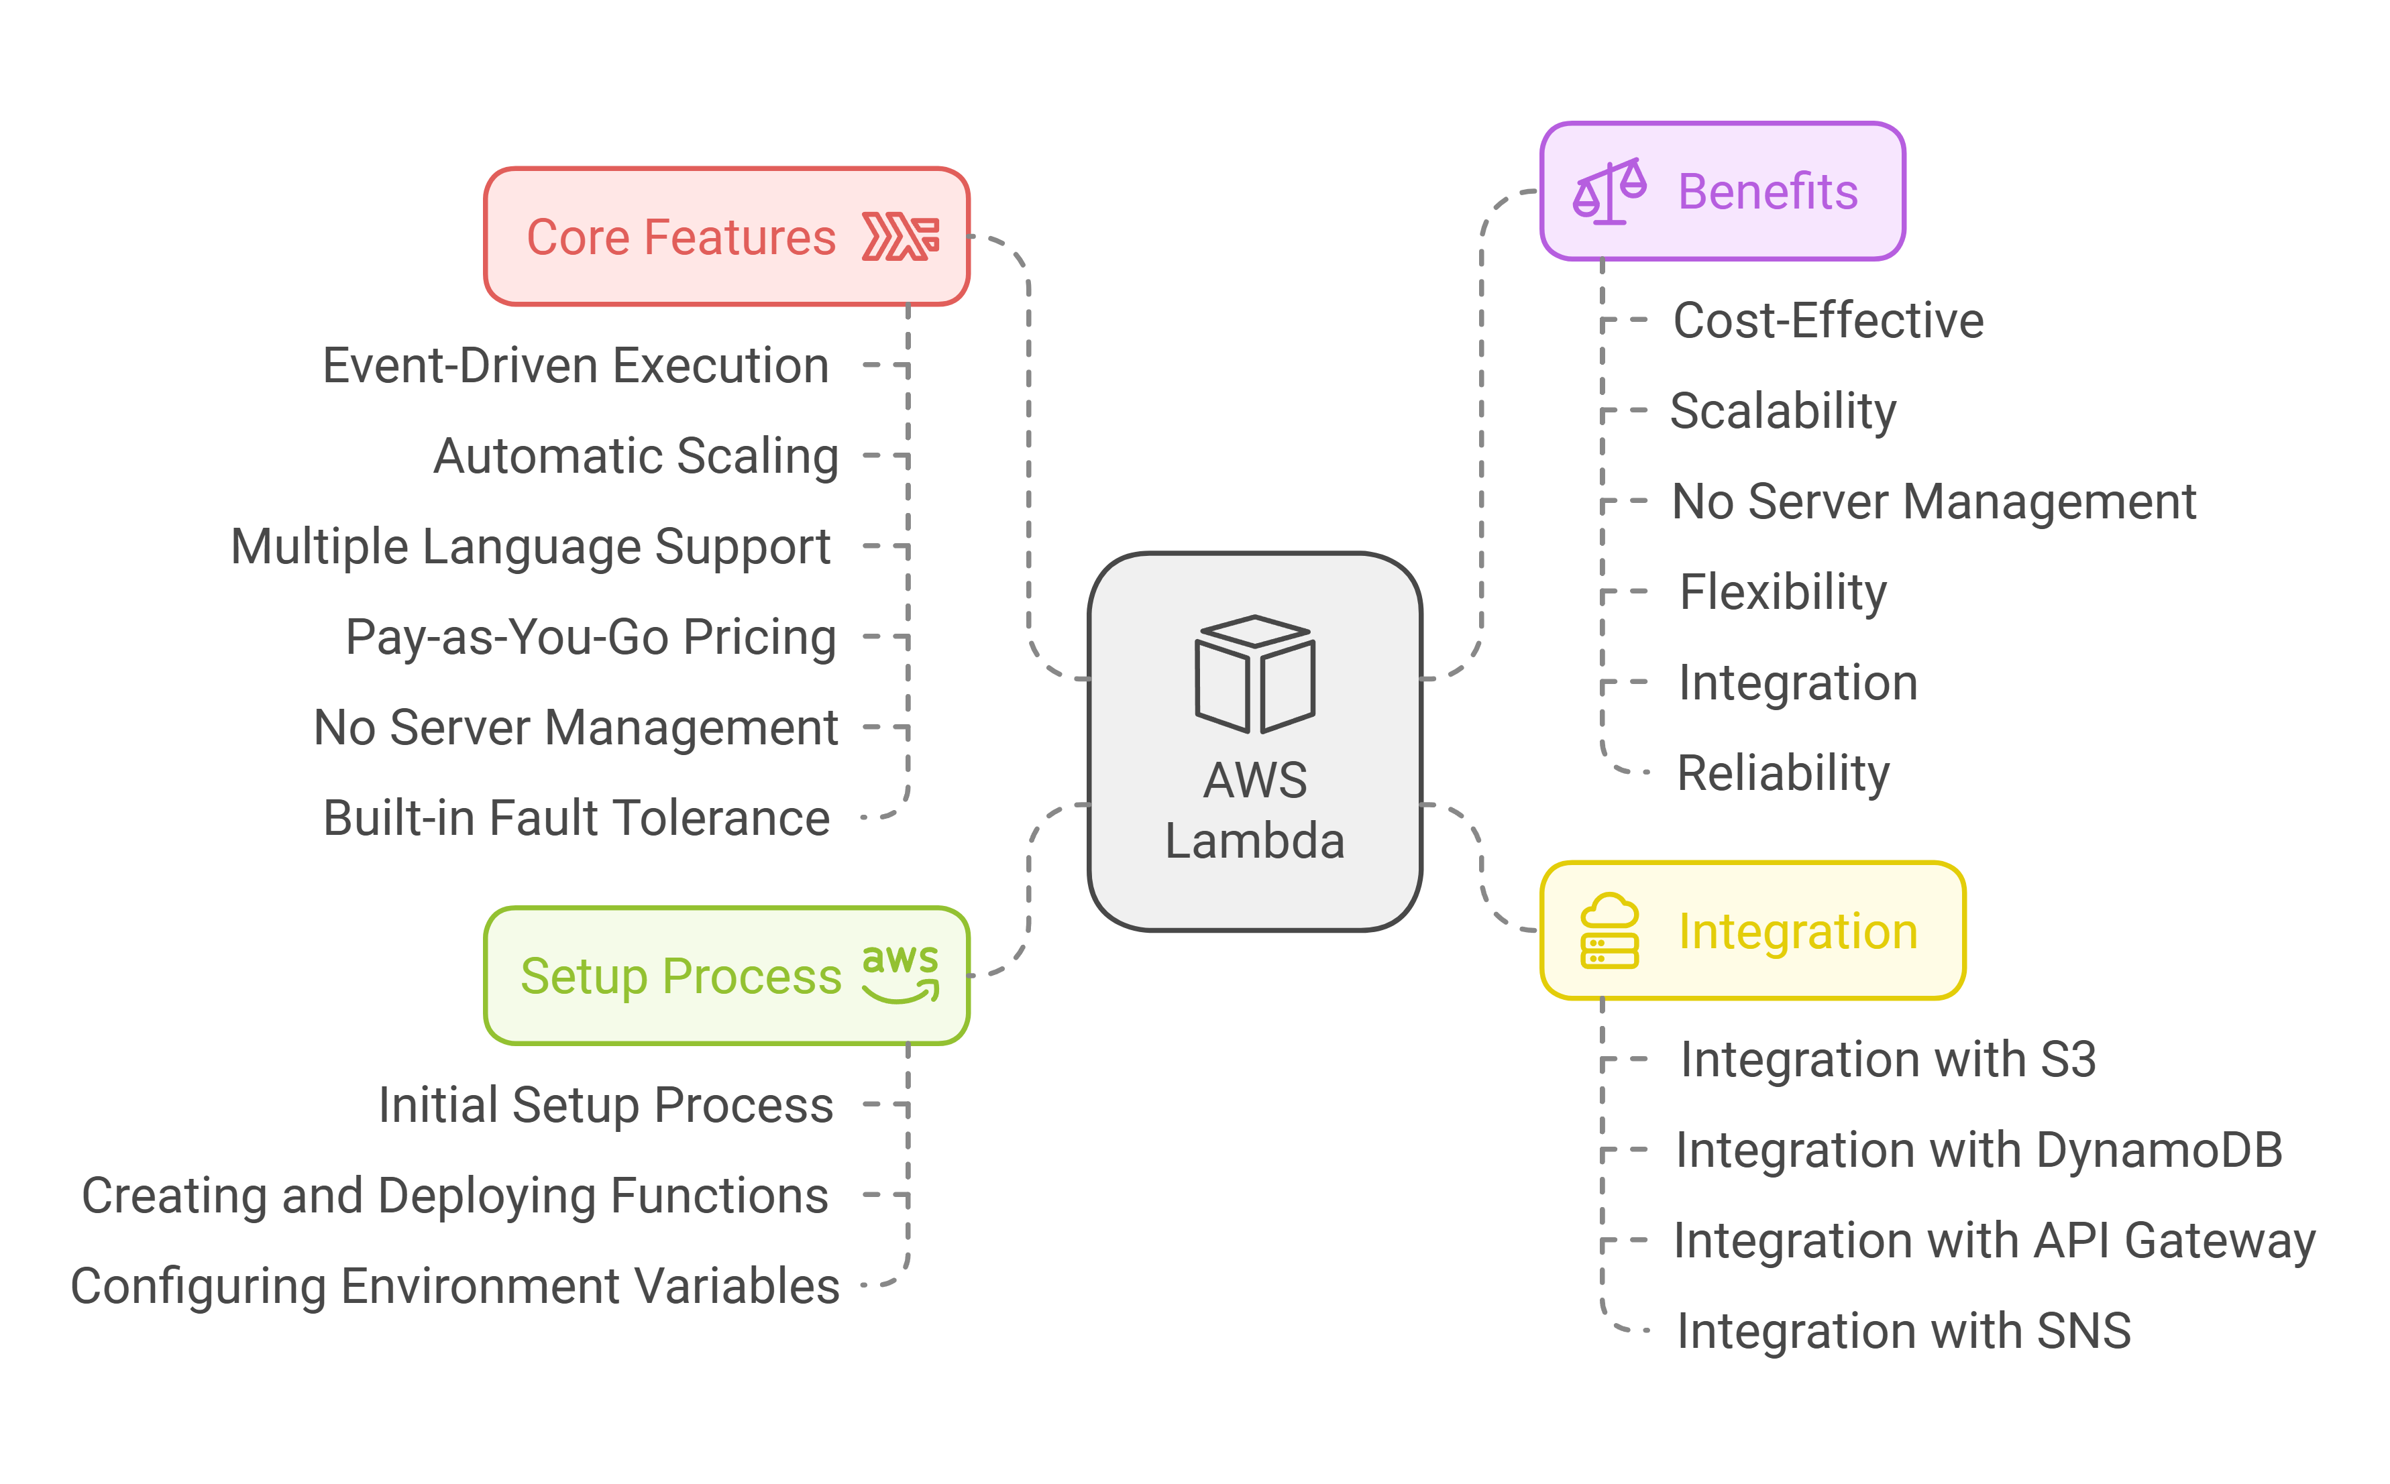
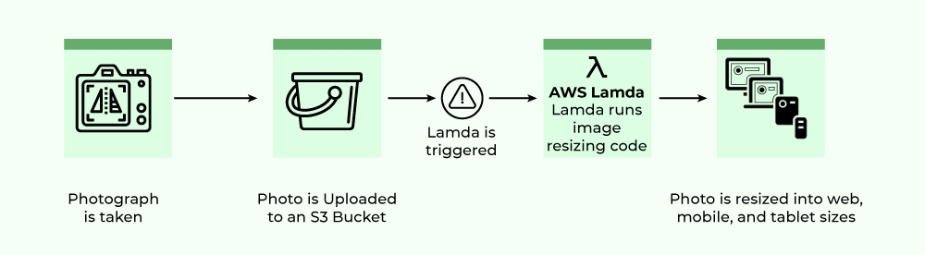
Automation – AWS Lambda
Purpose: Serverless compute service that runs code in response to events.
No servers to manage. Pay per execution.
Use cases in ML:
Trigger a retraining job when new data arrives in S3.
Run preprocessing or data validation automatically.
Build event-driven pipelines.
Example:
File uploaded to S3 → triggers Lambda → starts a SageMaker training job.
Limit: Lambda stops after 15 minutes, so it starts long jobs but does not run them.

Slide 12
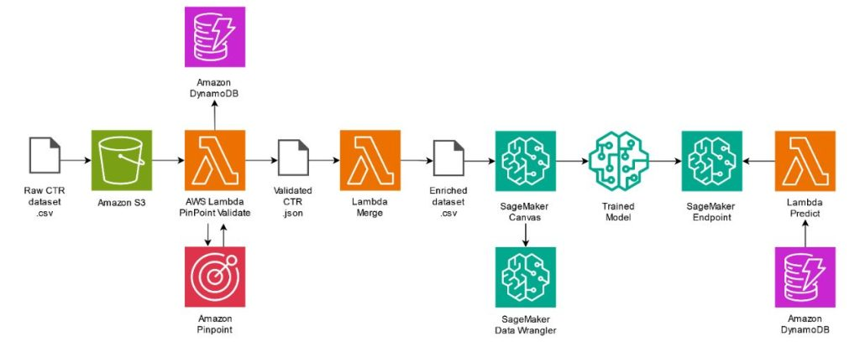
Amazon SageMaker AI – End-to-End ML Platform
Why it matters: Simplifies ML workflow from data prep to deployment.
Modules:
SageMaker Studio – interactive dev environment.
SageMaker Processing – data preprocessing jobs.
SageMaker Training – scalable model training.
SageMaker Model Registry – version control for models.
SageMaker Endpoints – deploy APIs for inference.

Slide 13
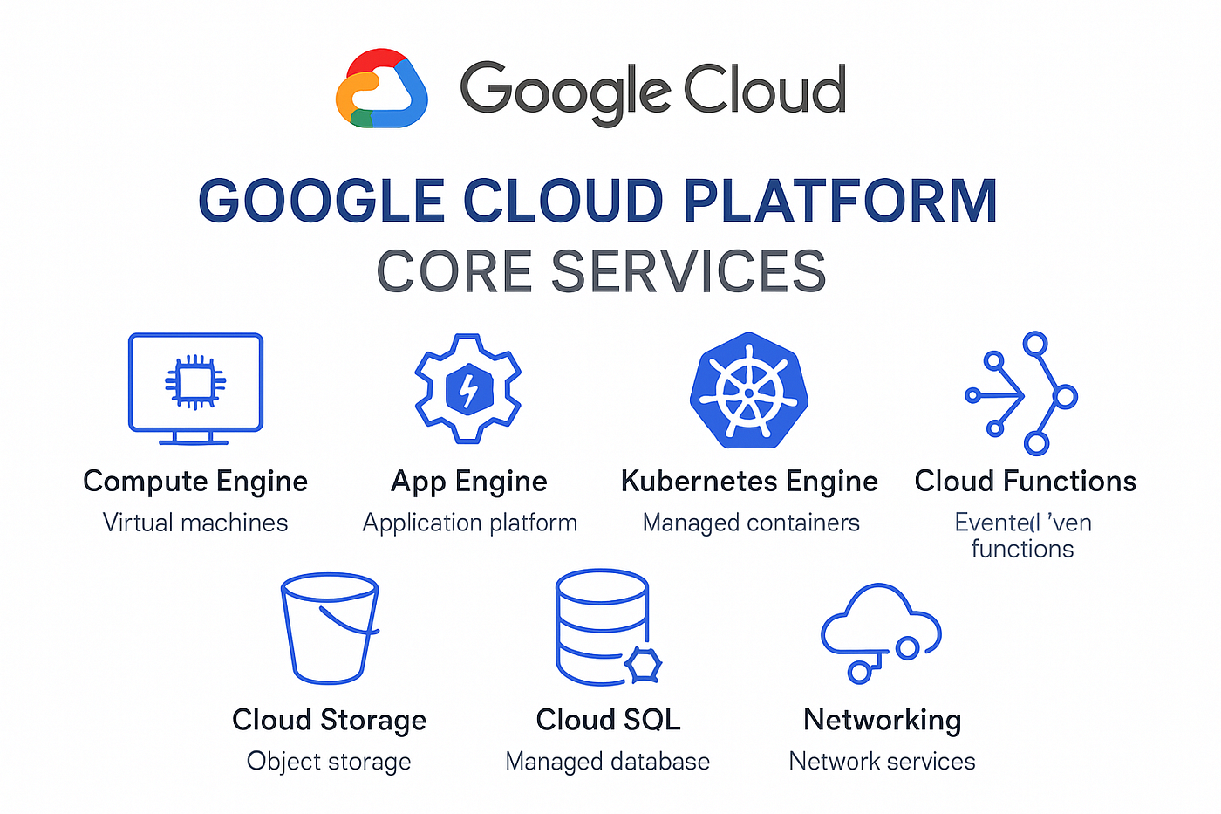
GCP Overview – Data-Centric Cloud
Google Cloud Platform Strengths:
Best for data analysis and ML research.
Deep integration with TensorFlow and JAX.
Offers powerful managed services.
Popular Services:
Vertex AI: Unified ML platform, including Gemini models.
BigQuery: Serverless data warehouse.
AutoML: Train models with minimal code.
Cloud Run functions: Event-driven serverless computing.

Slide 14
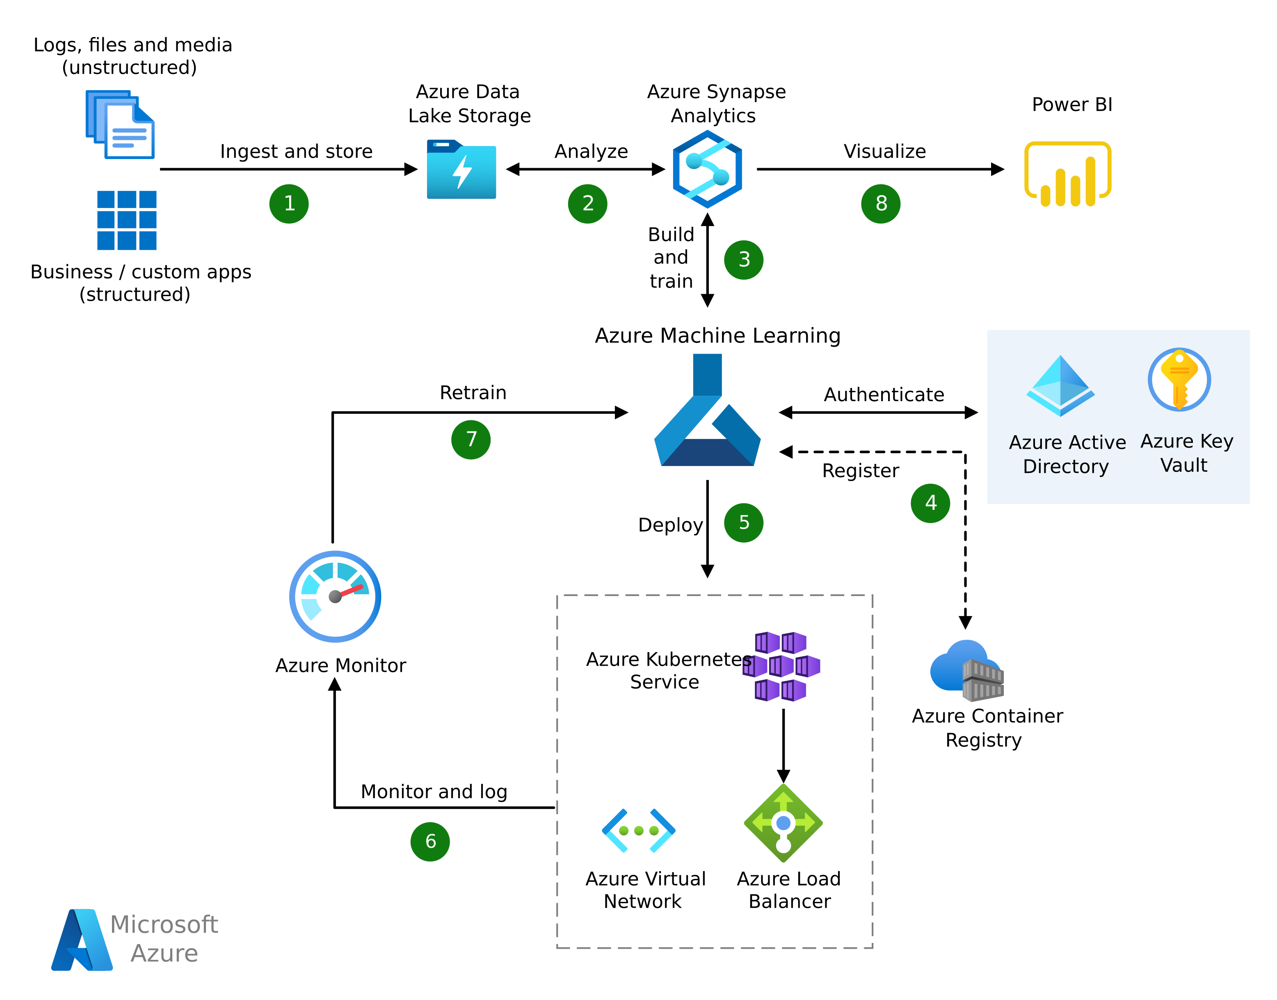
Azure Overview – Enterprise AI Cloud
Microsoft Azure Strengths:
Seamless integration with Microsoft ecosystem.
Strong enterprise adoption.
Popular Services:
Azure Machine Learning: Build, train and deploy custom models.
Microsoft Foundry: Models and agents for generative AI (formerly Azure AI Foundry).
Azure Data Lake: Storage for big data.
Azure Synapse Analytics: Analytics engine.
Azure Functions: Serverless automation.

Slide 15
Same Job, Three Clouds
Need | AWS | Google Cloud | Azure
Virtual machines | EC2 | Compute Engine | Virtual Machines
Object storage | S3 | Cloud Storage | Blob Storage
Serverless code | Lambda | Cloud Run functions | Azure Functions
Data warehouse | Redshift | BigQuery | Synapse Analytics
ML platform | SageMaker AI | Vertex AI | Azure Machine Learning
Hosted LLMs (GenAI) | Bedrock | Vertex AI (Gemini) | Microsoft Foundry
Access control | IAM | IAM | Microsoft Entra ID + RBAC

Slide 16
Popular Open-Source Cloud Tools
Category | Tool | Description
Infrastructure | Terraform | Infrastructure as Code for all clouds.
Containerization | Docker | Package apps and ML models.
Orchestration | Kubernetes | Automate container deployment/scaling.
Monitoring | Prometheus, Grafana | Track system and model performance.

Slide 17
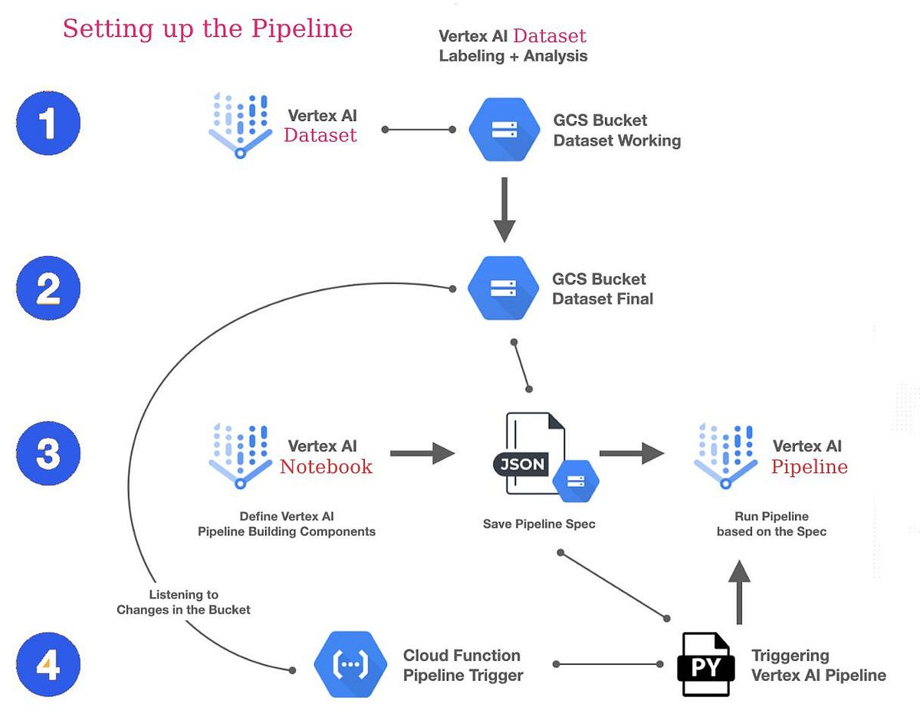
Real-World ML Workflow on Cloud
Storage: S3 / BigQuery
Training: EC2 / SageMaker / Vertex AI
CI/CD: GitHub Actions + Docker
Monitoring: Prometheus / CloudWatch

Slide 18

Cloud Cost Management
Strategy | Description
Free Tier | New AWS accounts get up to $200 in credits on a free plan that ends after 6 months. Set a budget alert first.
Spot Instances | Low-cost compute for work that can be interrupted.
Auto Scaling | Scale resources based on load.
Budgets & Alerts | Track spending and prevent surprises.

Slide 19
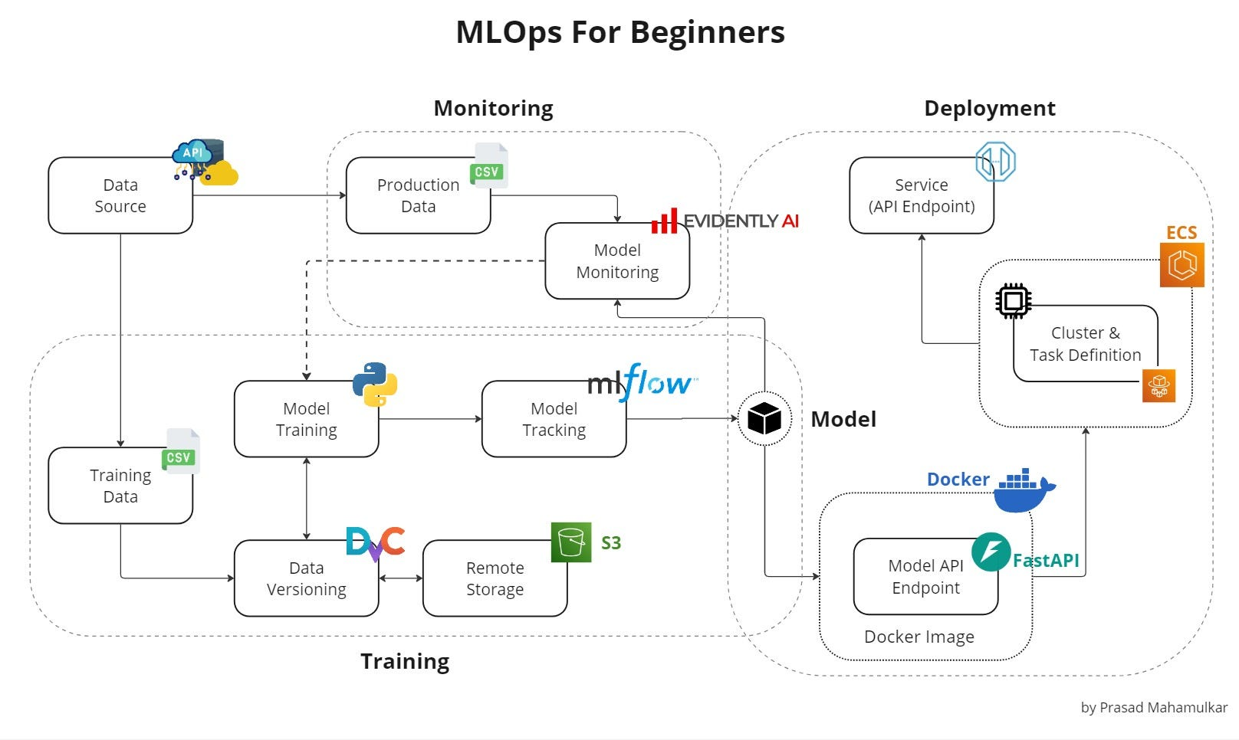
Train and track the model, package it in Docker, deploy it behind an API, then monitor it in production.

Slide 20
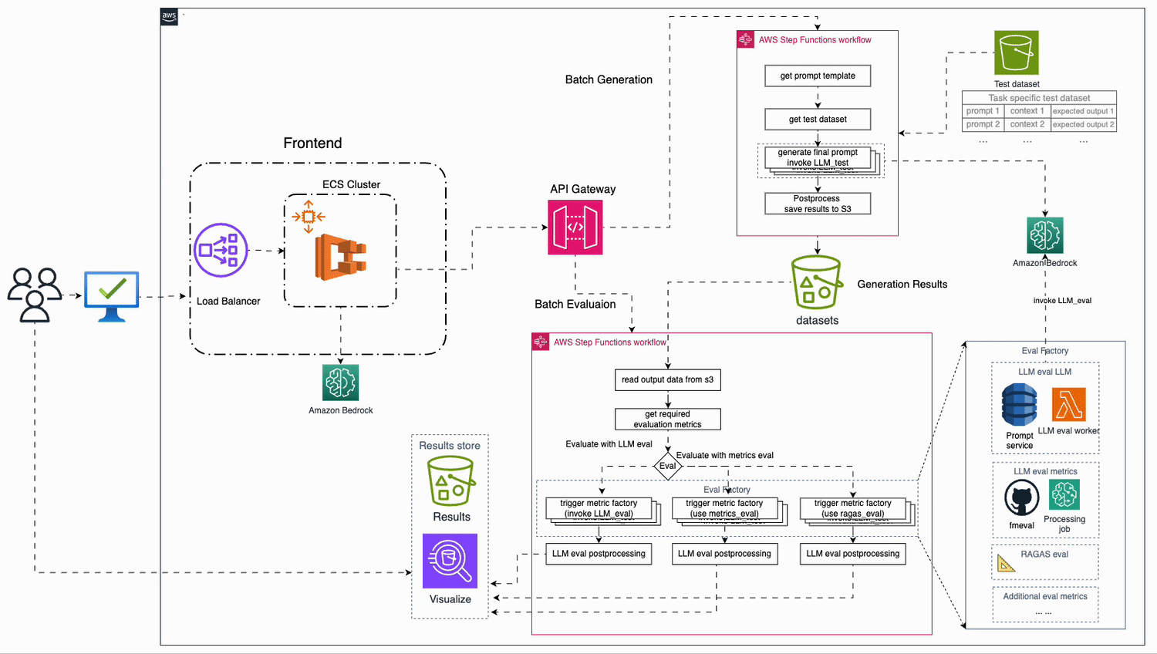
Example: GenAI Evaluation Pipeline on AWS
Test prompts go to a model on Amazon Bedrock, then Step Functions score the answers with LLM judges and metrics.

Slide 21
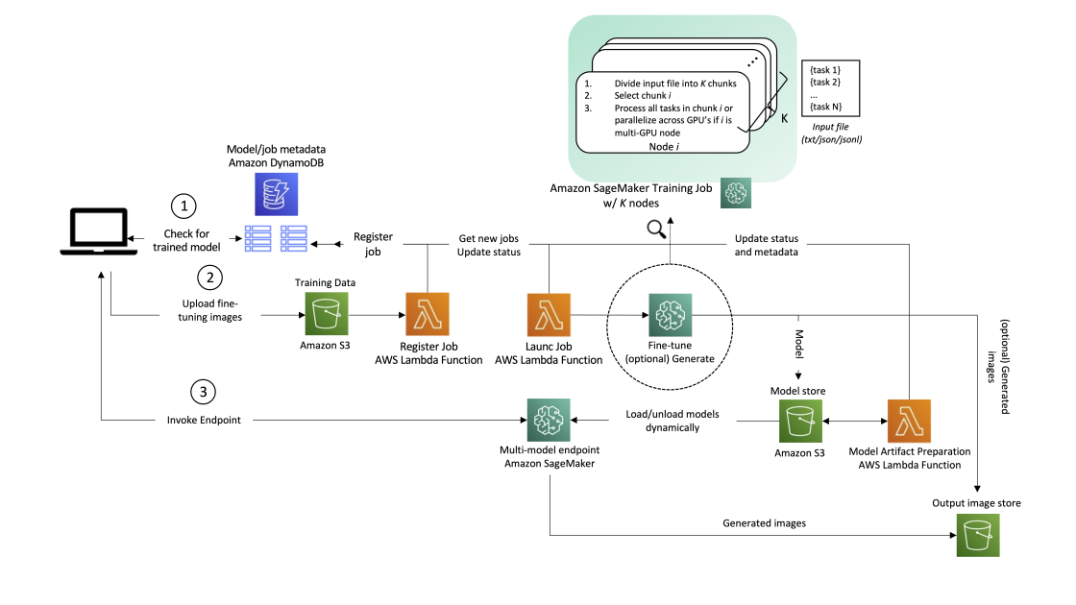
Example: Fine-Tune and Serve a Model on SageMaker AI
Lambda functions register and launch a SageMaker training job, and one endpoint serves the fine-tuned models.

